Slide 1
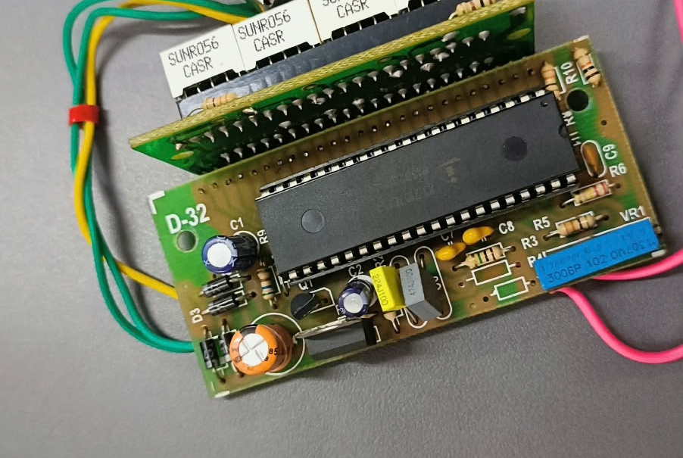
GROUP-56
Digital
Panel Meter
Yashank Bhatt
Aryan Kapoor
Navya Goel
Harsh Tyagi

Slide 2
PART I – STUDYING THE PRODUCT

Slide 3
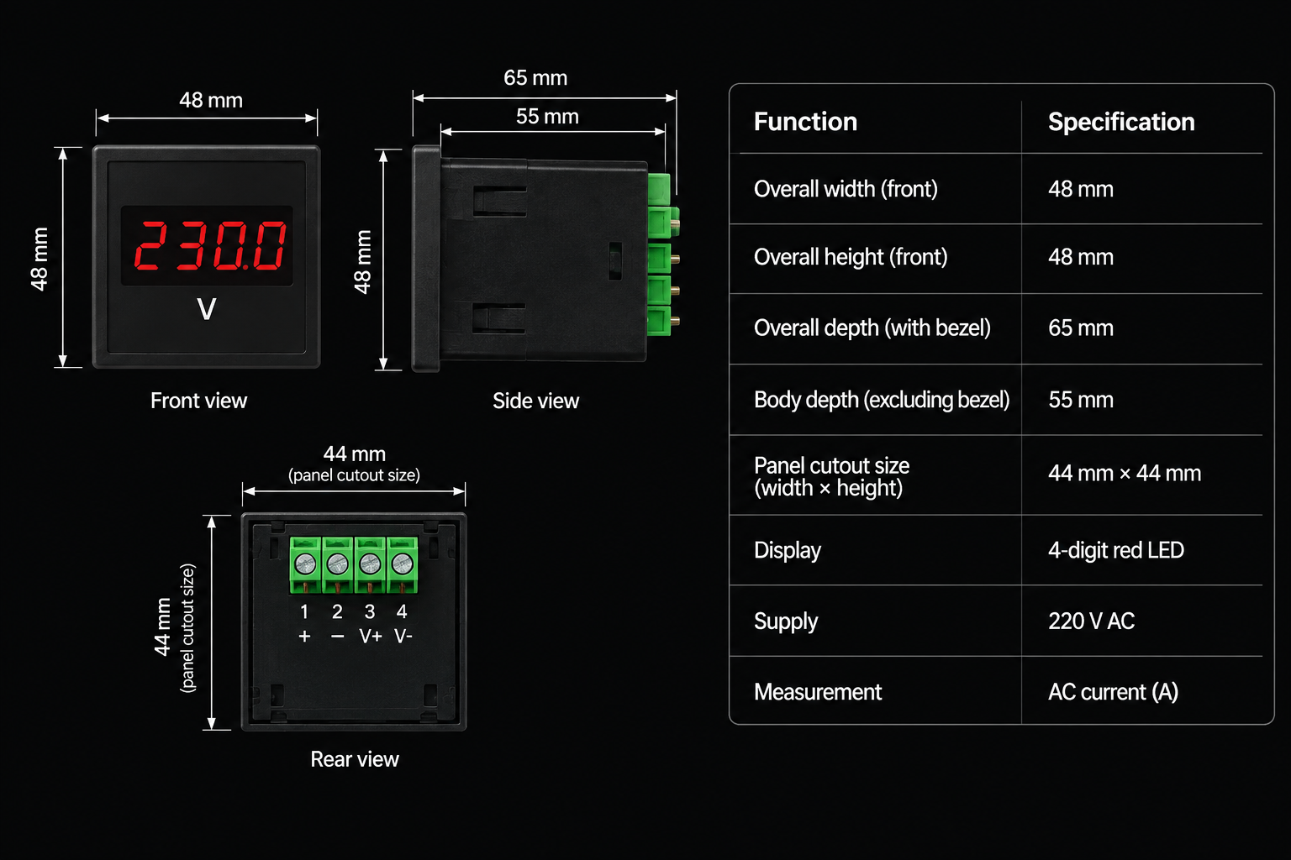
Dimensions

Slide 4
Purpose of the Product
  Reads electrical parameters (Voltage, Current, Frequency, Power Factor) in real-time with high precision (0.2%-0.5\% accuracy class).
  Eliminates parallax error associated with legacy analog meters.
  Triggers alarms or control circuits via relay outputs when preset thresholds are exceeded.

Slide 5
User Needs Addressed
  Accuracy & Clarity: Easy digital readability in dark or noisy industrial control rooms.
  Space Efficiency: Compact DIN-standard form factor that fits seamlessly into motor control centers (MCC) and distribution boards.
  Automation Integration: RS485 (Modbus RTU) communications interface to feed real-time energy usage data into SCADA/PLC networks.

Slide 6
PART II – PRODUCT ORIGIN TO LATEST INVENTIONS

Slide 7
1. Difference in Technology Across Versions
1.1 Early Stage (Analog D’Arsonval / Moving Iron Meters):
  Improvements: Simple, self-powered, required no digital conversion.
  Drawbacks: Parallax error, friction loss, mechanical wear, sensitive to vibrations and magnetic interference.
1.2 First Generation Digital (Discrete IC & ADC-based):
  Improvements: Dual-slope ADC ICs (e.g., ICL7107) driving 7-segment displays directly.
  Drawbacks: Fixed function (voltage/current only), non-programmable, bulky discrete circuitry.

Slide 8
1. Difference in Technology Across Versions
1.3 Second Generation (Microcontroller-Driven):
  Improvements: Added 8-bit microcontrollers (8051/PIC), EEPROM memory, configurable CT/PT ratios, and basic RS232/RS485 communication.
  Drawbacks: Slower sampling rate, limited True-RMS calculation capability.
1.4 Latest Generation (Smart / IoT Digital Panel Meters):
  Improvements: 32-bit ARM Cortex M microcontrollers, DSP units, True-RMS measurement, THD (Harmonic Analysis), OLED/TFT displays, Ethernet/Wi-Fi/Modbus connectivity.
  Drawbacks: High design complexity, vulnerable to cybersecurity risks in networked environments.

Slide 9
Current Status – Core Smart Technologies Used in Product
  32-Bit Embedded Microcontrollers / DSPs: For simultaneous multichannel True-RMS computation.
  Energy Metering ASIC / Precision Sigma-Delta ADCs: High dynamic range with up to 24-bit resolution.
  RS-485 Modbus RTU / MQTT Communications: Direct cloud/SCADA connectivity for predictive maintenance.
  Non-Volatile FRAM/EEPROM: Stores calibration factors, log files, and peak power outages without data corruption.

Slide 10
3. Engineering Importance of This Evolution
Transitioned industrial power management from periodic manual visual monitoring to automated continuous data collection and energy auditing.

Slide 11
PART III – INTERNAL COMPONENTS & WORKING FLOW

Slide 12
1. Introduction of the Product
  The Digital Panel Meter is a high-precision, microprocessor-controlled electronic instrument that converts continuous analog physical parameters into calibrated numerical readout displays.

Slide 13
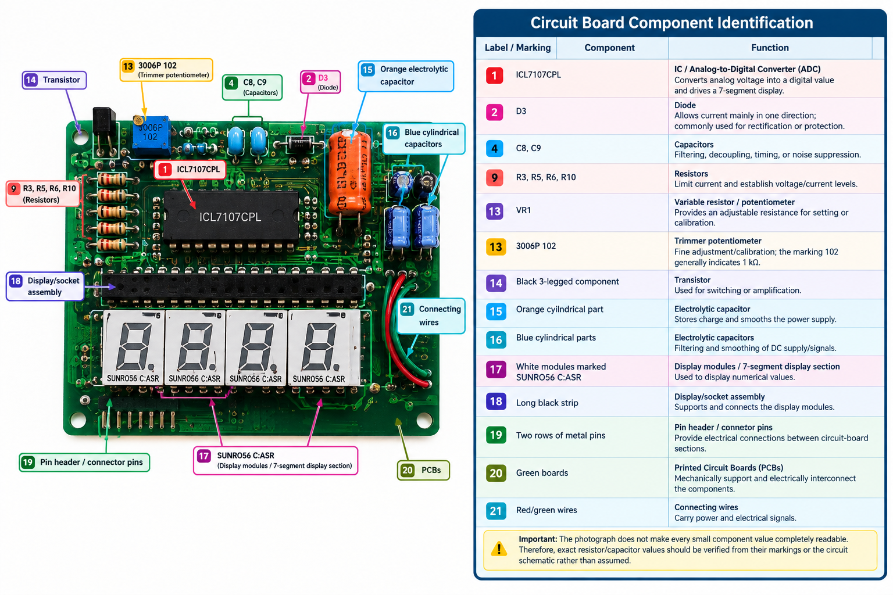

Slide 14
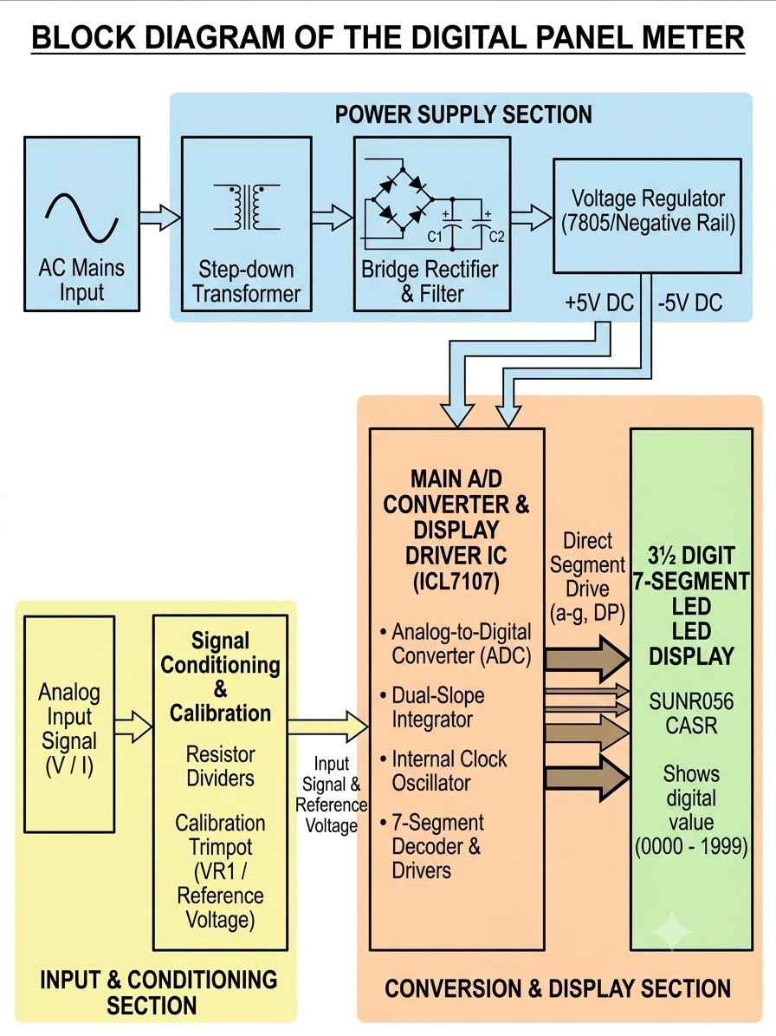
Block Diagram

Slide 15
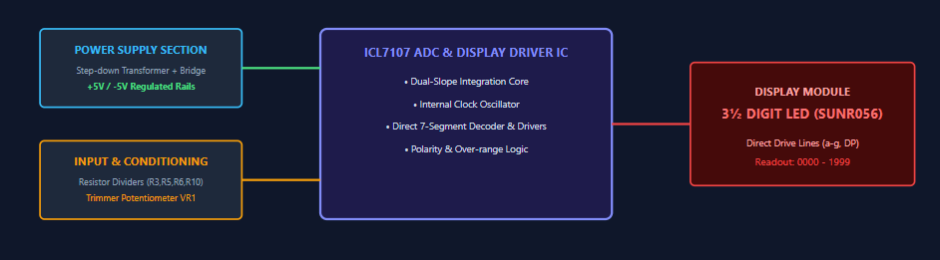

Slide 16
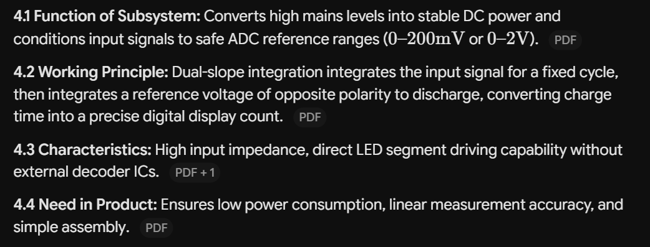
Internal Subsystems with Detailed Explanation

Slide 17
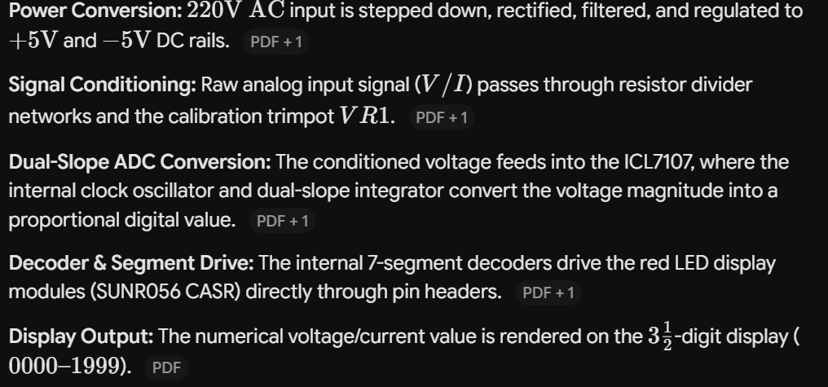
Complete Working Flow

Slide 18
PART IV – SIMULATION & RESULTS

Slide 19
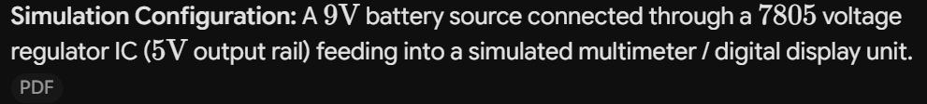
Circuit Diagram of the Product

Slide 20
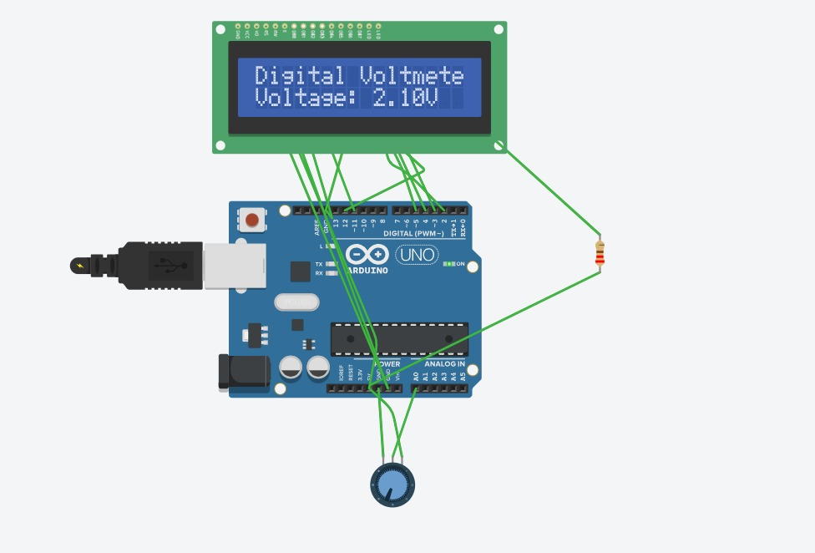

Slide 21
Link of the Video
https://www.tinkercad.com/login?next=%2Fthings%2FlP2VD7PrT4F-digital-voltmeter

Slide 22
THANK YOU

